Slide 1
SpokenText Reader (STR) v2 A Study Support Mobile Application for Visually and Learning Impaired students
By: Mark McKay – mark@zambadu.com – 613 322-2210
Date: April 13, 2020
V1

Slide 2
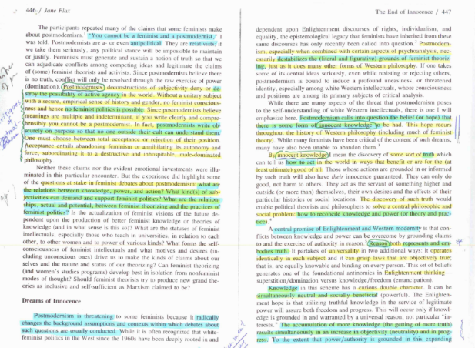
What is the audio equalivant of?

Slide 3
Motivation
SpokenText Reader (STR) will aid me in my PH’D
STR will be an open source, iOS app that is bias to audio not text. Developed using SCRUM over time.
Will let me: critically read a large number of research articles, reflect on them, sight portions of them in presentations and papers and discuss them in class. While not braking my sense of flow and mental thought.
Results from my thesis work will inform the design of version 2 of SpokenText Reader
App is audio focused, but the synced raw text is only a swipe away. Useful when the TTS says the wrong words, or you want to review tables or pictures contained in the text.

Slide 4
Best of both worlds
E-text under the hood but offers two interfaces
User experience biased to audio, with audio generated on demand via TTS.
User experience biased to interacting with the e-text and optionally a TTS audio stream
With this hybrid design, print disabled people could decide for themselves which approach they wanted to use for consuming the material and might even switch between the two depending on the material they were consuming.

Slide 5
Questions
How should we code the app to support an audio first interface? Can OnDemand speech generation work?
User needs the ability to interact with the auto generated speech like it was pre-recorded
Smooth rewind/fast forward
Smooth scrubbing of audio
No pause in audio stream when moving from line to line of text.
Should we generate the speech sentence by sentence and cache the current position and the line before and after?
Should we linearize the text and feed it to the TTS in large chunks. This is how STR v1 recorded text to mp3. Text was extracted and feed to TTS in one huge file.
Can an iPhone X or 11 generate speech on the fly and send it to Bluetooth headphones with no lag? V5 of Bluetooth working well in testing. V4 had lag when testing with Voice Dream and a BuckShot MP3 speaker.
Do we need to cache the audio, to provide a pre-recorded like feel, If so what is the best way to do this?

Slide 6
Primary STR v2 Screen flow
Library
Text
(shown on swipe)
Player
Notes
View Note
Add Note
Edit Note

Slide 7
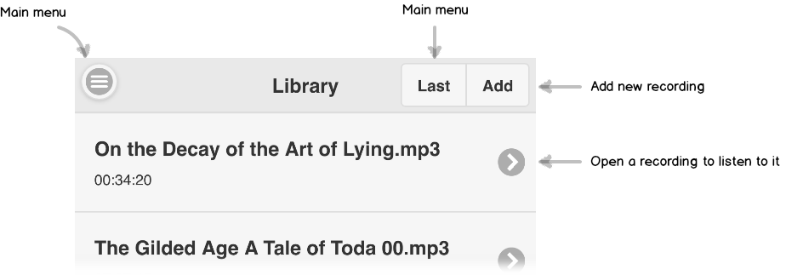
Library screen

Slide 8
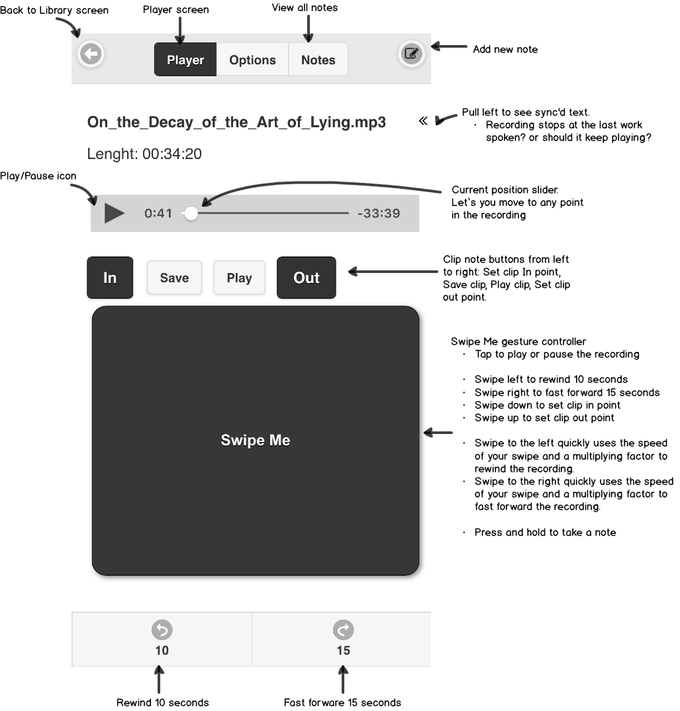
Audio Player screen

Slide 9
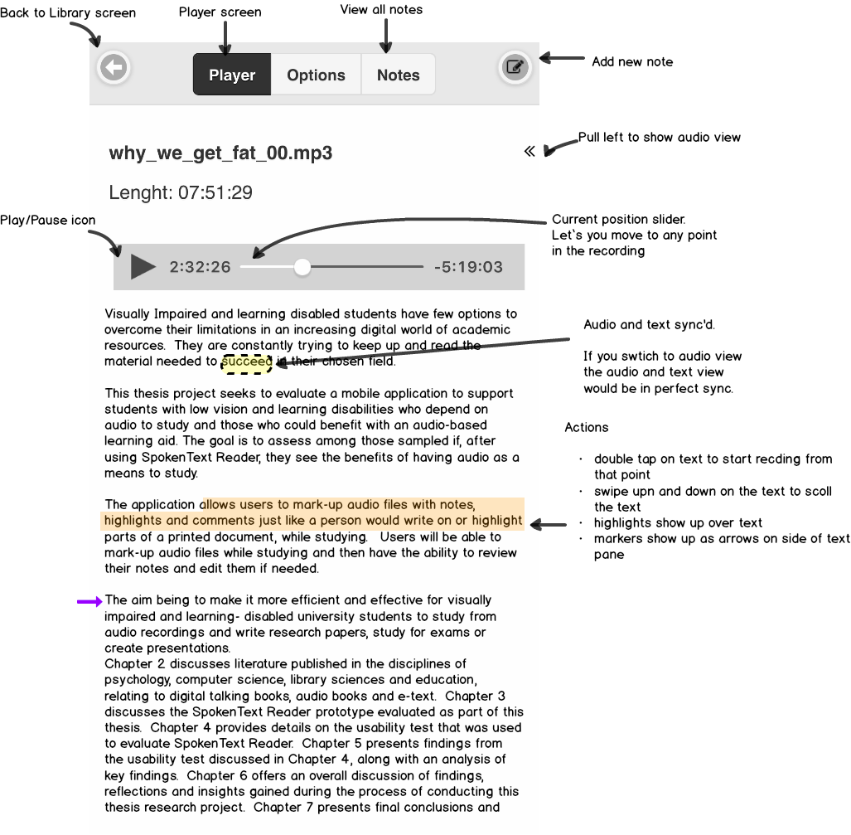
Text screen

Slide 10
Extra

Slide 11
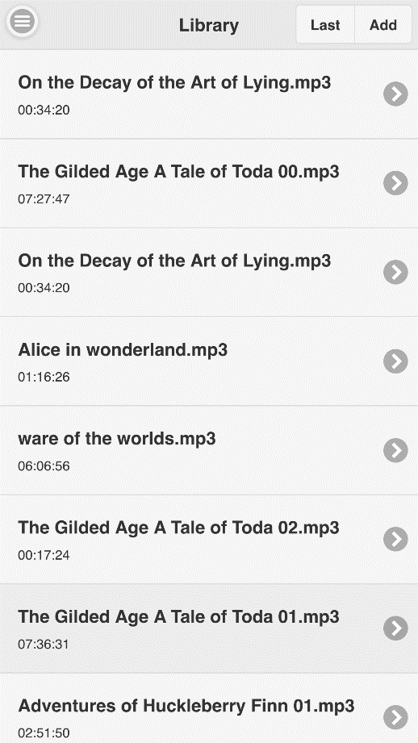
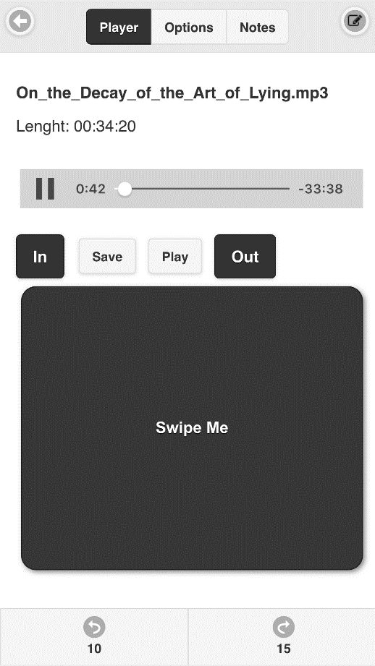
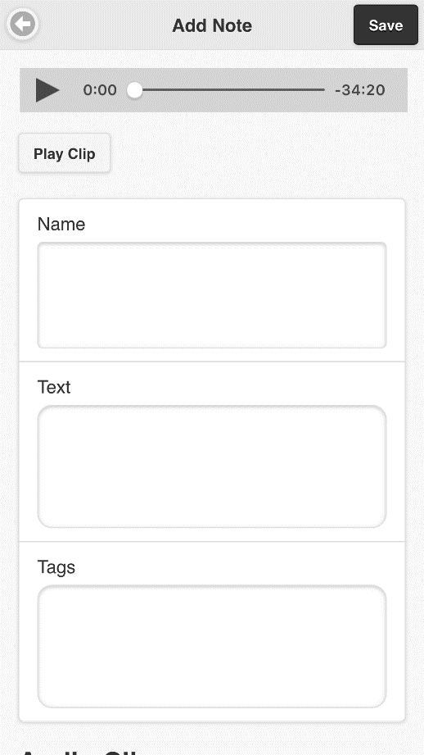
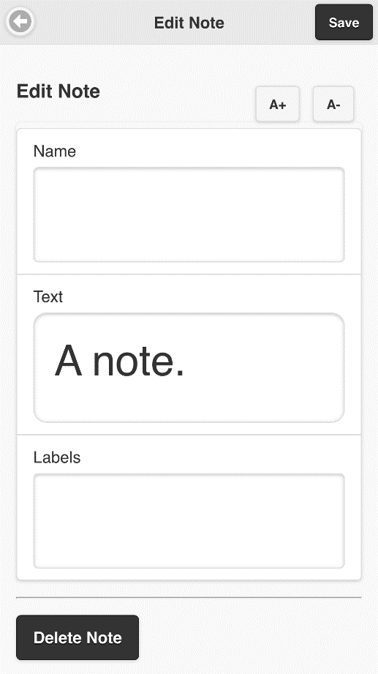
Figure 13: Edit note screen
Figure 11: Shows the main player screen (left) and the Add new note screen (right) which is

Slide 12
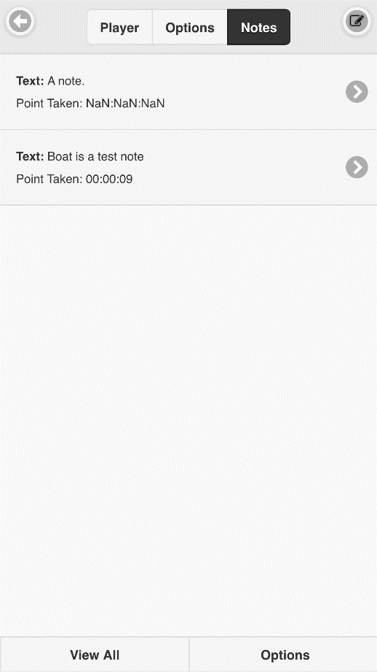
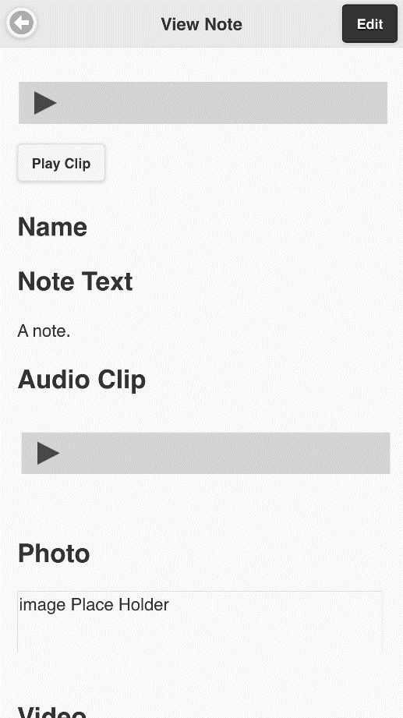
Figure 12: View all notes screen (left) View note screen (right)

Slide 13
Defining the print disabled
Centre for Equitable Library Access (CELA) defines print disability as follows: a learning, physical or visual disability that prevents a person from reading conventional print.
Learning disability: An impairment relating to comprehension
Physical disability: The inability to hold or manipulate a book
Visual disability: Severe or total impairment of sight or the inability to focus or move one’s eyes

Slide 14
Literature Review
Categorized into
Digital talking books
Audio books
E-text
Gap
From the review of the literature, we can see that there has been a lot of progress made to provide better access to print material for print disabled people. However, there is little research around how to support students trying to use audio created from printed material for study purposes. Regardless of whether it is, audio generated in real time or prerecorded audio in the form of audiobooks.
To add to the literature in this area, this thesis set out to research a solution to help students take notes and annotate audio they were using to study.

